Slide 1
Dynamic Cloud-Based Application with CI/CD Integration
Submitted by: Jeswanth Appasani
Module: Cloud Dev-ops
College: National College of Ireland

Slide 2
Abstract
A user-friendly cloud app hosted on AWS EC2.
Supports CRUD operations with SQLite database.
Integrated CI/CD pipeline for smooth updates.
Real-time monitoring with AWS CloudWatch.
Focused on simplicity, security, and efficiency.

Slide 3
Introduction
Cloud computing makes applications scalable and flexible.
This project uses AWS tools for hosting and monitoring.
Objectives:
Build a reliable cloud-based application.
Ensure security and user-centered design.

Slide 4
Architectural Design
Platform: AWS EC2 for scalability.
Frontend: Simple HTML & CSS for responsiveness.
Backend: Flask for handling app logic.
Database: SQLite for lightweight storage.

Slide 5
Architecture Components
Frontend: Clean and user-friendly design.
Backend: Flask manages CRUD operations.
Database: Efficient data handling with SQLite.

Slide 6
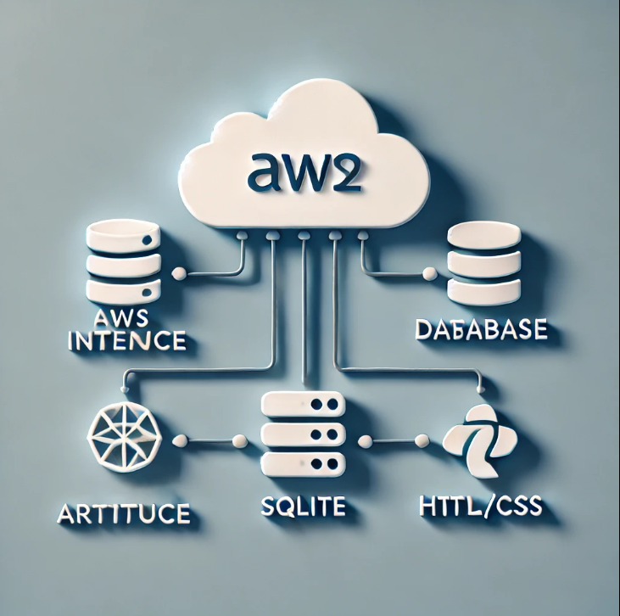
Cloud Based Architecture

Slide 7
CI/CD Pipeline
Automates app updates and deployments.
Uses GitHub for version control.
AWS tools ensure secure and efficient deployment.

Slide 8
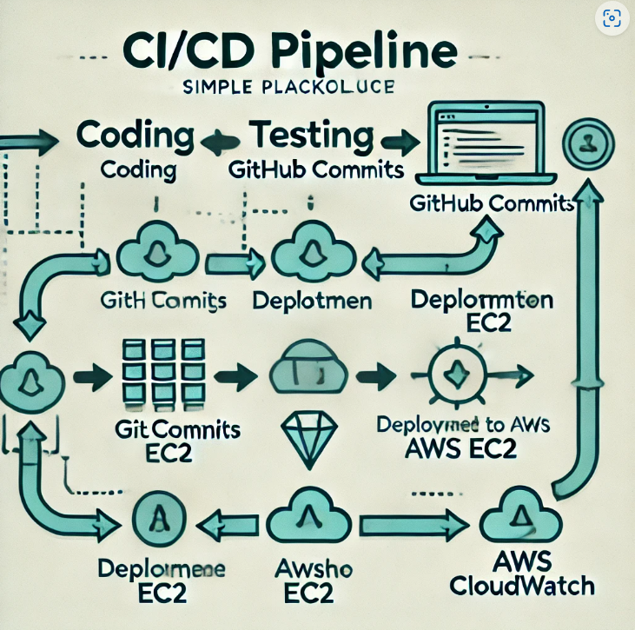

Slide 9
Pipeline Implementation
Steps:
1. Code managed via GitHub.
2. Local tests validate changes.
3. Files deployed securely to AWS EC2.
4. Monitoring through AWS CloudWatch.

Slide 10
Deployment on AWS
Uses Ubuntu-based EC2 instance (free tier).
Tools installed: Python, Flask, Gunicorn.
Files securely transferred via SCP.
Monitored using AWS CloudWatch.

Slide 11
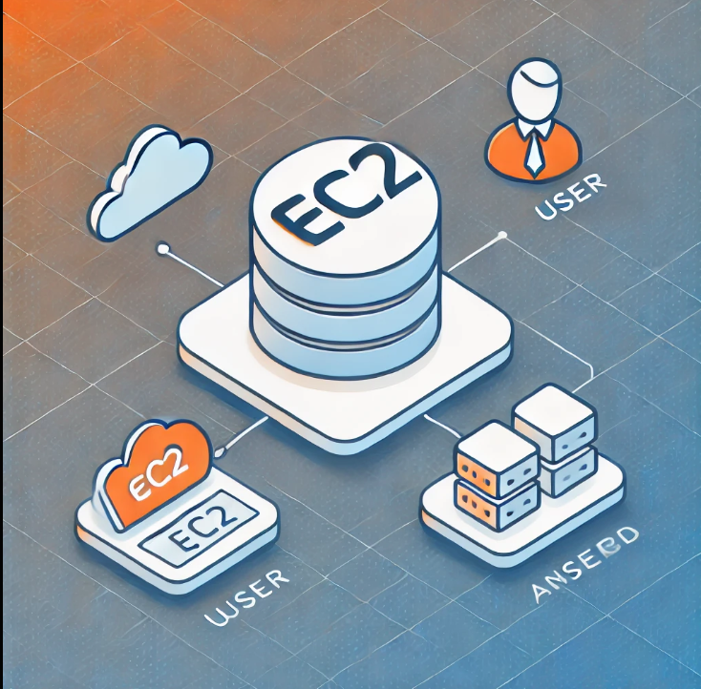
AWS EC2 instance deployment

Slide 12
Static Code and Security
Static Code Analysis:
Pylint checks for clean, readable code.
Security Testing:
Tools like OWASP ZAP detect vulnerabilities.

Slide 13
Code Highlights
Key Features:
CRUD operations for tasks.
Error-free connection between frontend and backend.

Slide 14
Frontend and Backend Views
Frontend:
Responsive task management interface.
Backend:
Handles API requests and database communication.

Slide 15
Monitoring with AWS CloudWatch
Tracks system performance and resource usage.
Provides real-time alerts for quick fixes.

Slide 16
Challenges and Solutions
Challenges:
Exposed credentials and SQL injection risks.
Fixes:
Environment variables and better validation.

Slide 17
Conclusion
A scalable cloud app leveraging AWS tools.
CI/CD pipeline ensures efficiency and reliability.
Real-time monitoring improves performance.

Slide 18
Future Scope
Expand to robust databases like PostgreSQL.
Add advanced monitoring tools like AWS X-Ray.

Slide 19
THANKYOU

